Slide 1

Project 4 – Predicting House Price Model
Nels Jacobson
Anisa Braun
Tanner Amman

Slide 2

Goal
Our goal for this project was to use a data set with different variables and attributes of residential houses, to build a model that can predict the sale price of a home.

Slide 3
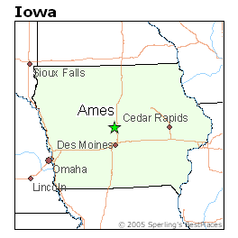
Data Set
Found on Kaggle, this data set is focused on residential homes in Ames, Iowa with different variables that determine house pricing.
Dataset includes a total of 79 different variables ranging from square footage, to central air, to foundation type to over all condition of the house.

Slide 4

Processes
-Importing libraries including Python Pandas and Python Matplotlib
Loading data sets
Basic understanding of the data set and different variables
Data processing, cleaning restoring and restructuring
Exploratory data analysis
Mode building and evaluation
Conclusion

Slide 5
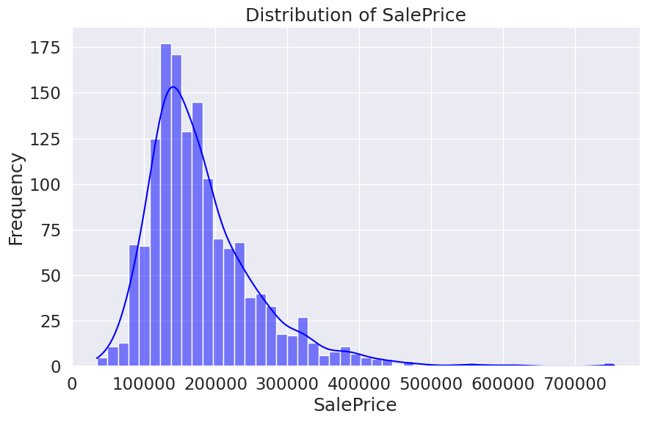
Distribution of sale price
Visual of distribution of sale price, showing house pricing from $100,000-$700,000.
This shows that there is a drastic increase, peaking at around roughly $150,000, with an almost as drastic increase shortly after.

Slide 6
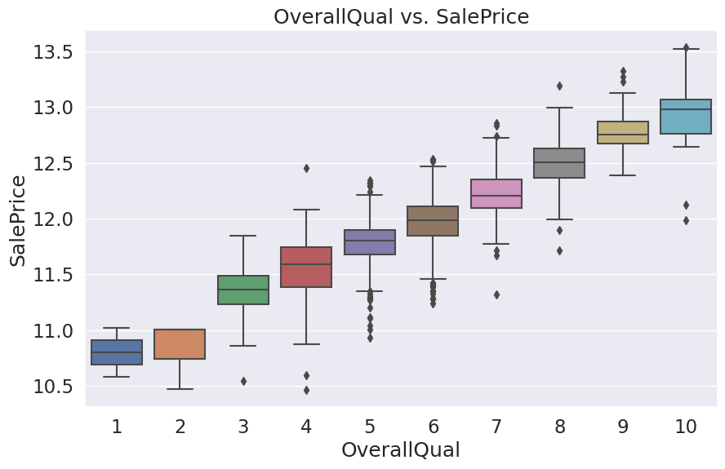
Overall quality
Visual showing the house price in comparison to the overall quality of the property.
We can see that there is a strong relationship between the greater quality of house and increase in sale price.

Slide 7
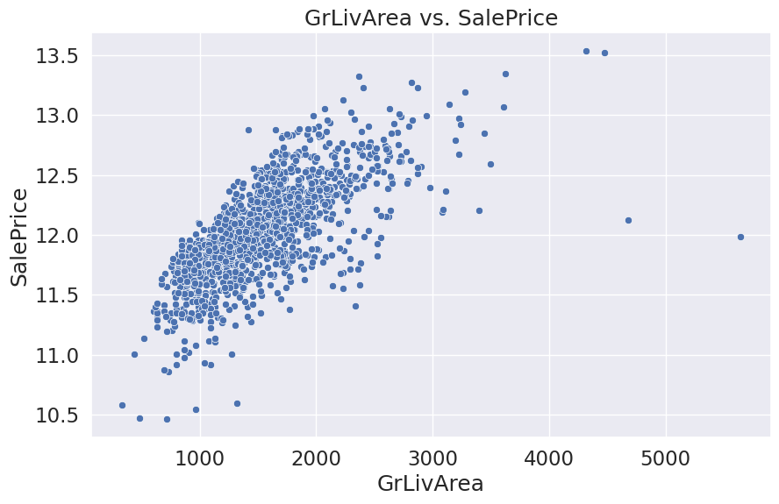
Grliv area
Grlivarea in this data set simply is the above-ground living space in square feet.
This visual is showing this, compared to the sale price of the house.
We can see that there is a very strong relationship between these two variables, where there is an increase in above ground living space, there is an increase in sale price.

Slide 8
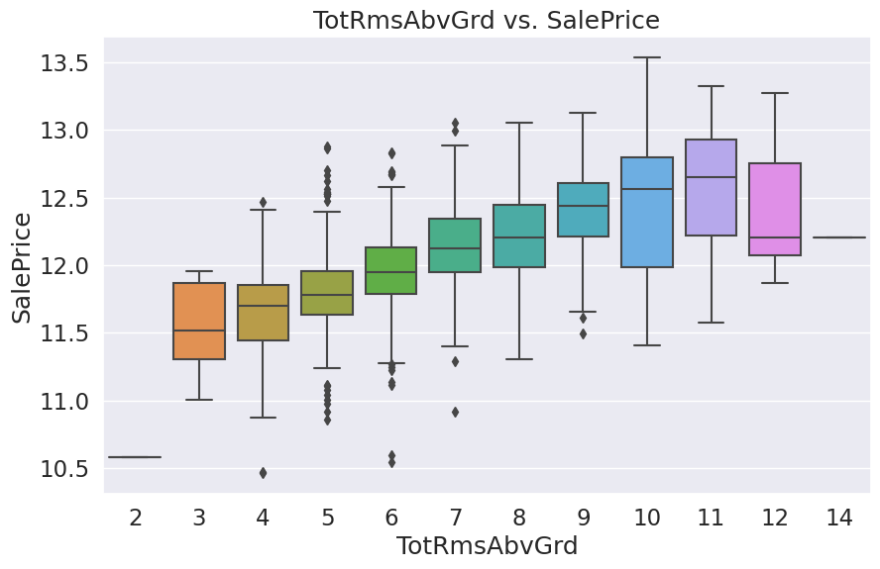
Total rooms above ground
This visual is showing the comparison in the total number of rooms above ground and the sale price of the house.
We can see here that there is a consistent increase of the sale price and the number of rooms, until we get to 12-14 rooms when we start to see a decrease in the sale price, even with larger number of rooms.

Slide 9
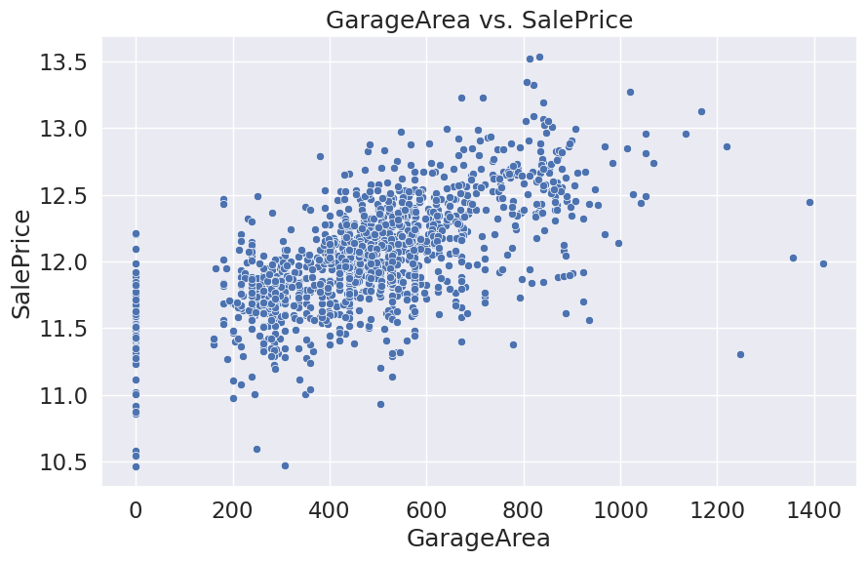
Garage area
Visual of the garage area in square feet in comparison to the sale price.
We can see that where there is an increase in garage space, there is typically and increase in sale price.

Slide 10
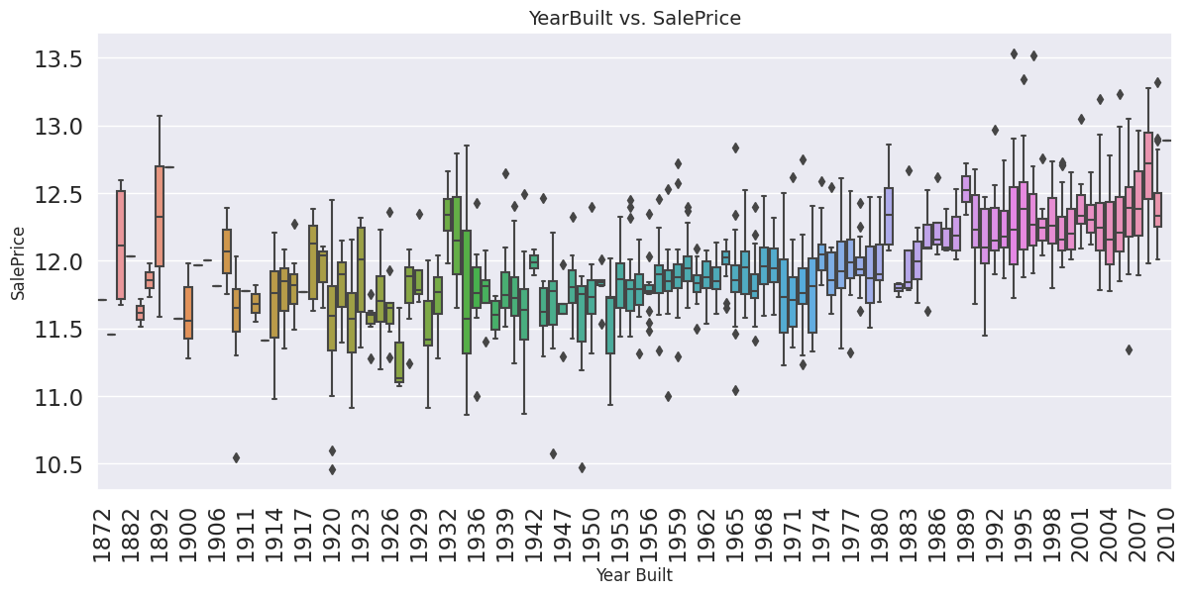
Year built
Comparison to the year the house was built, and sale price of the home.
There is not as strong of a relationship here as other variables, but still a pattern of increase in sale price and newer built homes.

Slide 11
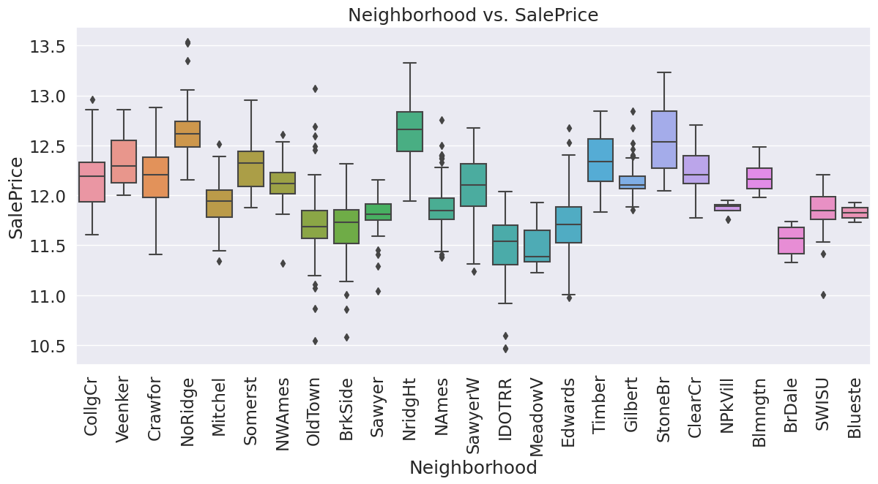
neighborhood
Comparison of neighborhood and area and sale price.
There is no strong relationship here, but research into these different neighborhoods show that there is an increase in sale price of the home with safer neighborhoods.

Slide 12
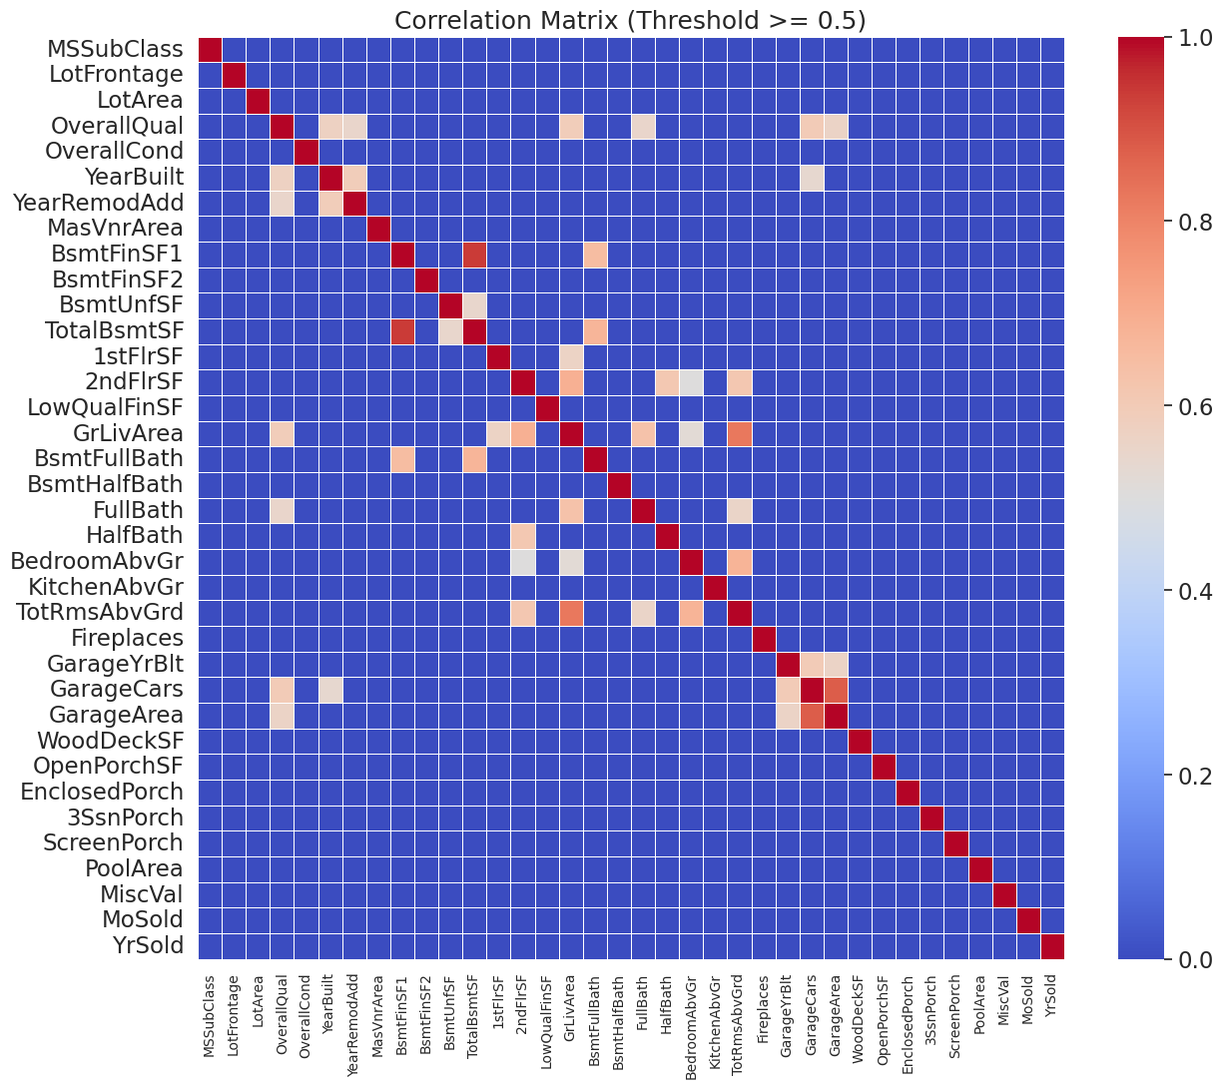
Correlation matrix
Correlation matrix with all variables included.

Slide 13

conclusion
TensorFlow Model: Scikit-learn Linear Regression Model:
Mean squared error of 18.78 Mean squared error of 0.04
R-squared value of -99.72 R-squared value of 0.76
Keras Model:
Mean squared error of 153.78
R-squared value of -823.08
XGBoost Model:
Mean squared error of 0.03
R-squared value of 0.87

Slide 14

conclusion
Comparing all different models, we found that the XGBoost Model gave us the best results with a Mean squared error of 0.03 and a R-squared value of 0.87.
If there was additional time, we would like to consider outside forces that were not included in this data set. Things such as different amenities, utilities, and possibly things such as HOA costs, nearby businesses, and travel accessibility to include in our model.

